Slide 1
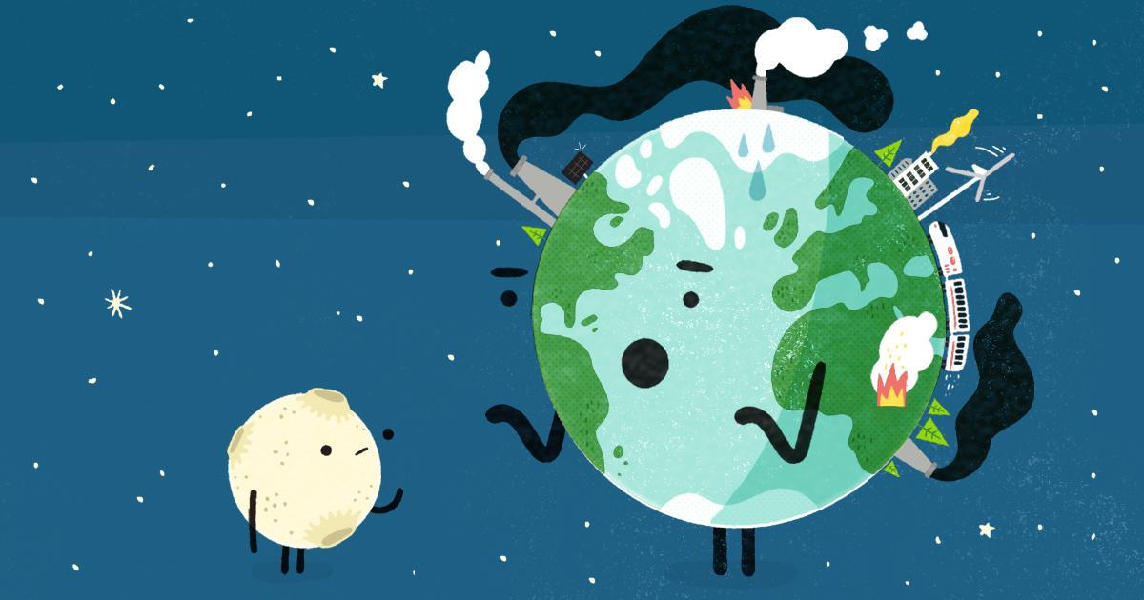
How can we find out more about what will change in our country as a result of climate change?
Group B

Slide 2
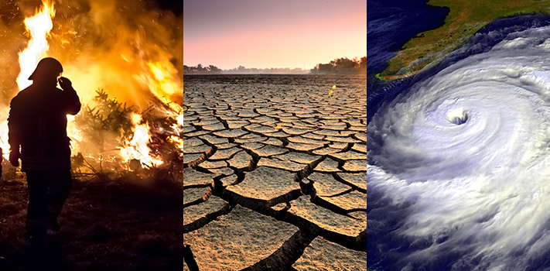
How can we find out more about what will change in our country as a result of climate change?
search on internet;
keep informed;
we can watch programs about climate change on tv.
we can ask to professional persons who are more into the topic

